Slide 1

Speaker Recognition
AI in Speech Processing (21AIE315)
TEAM -

Slide 2

TEAM MEMBERS
ABIJITH [CBENU4AIE19002]
ANIRUDH BHASKAR [CBENU4AIE19007]
KARTHIK [CBENU4AIE19020]
SUHAS [CBENU4AIE19042]

Slide 3
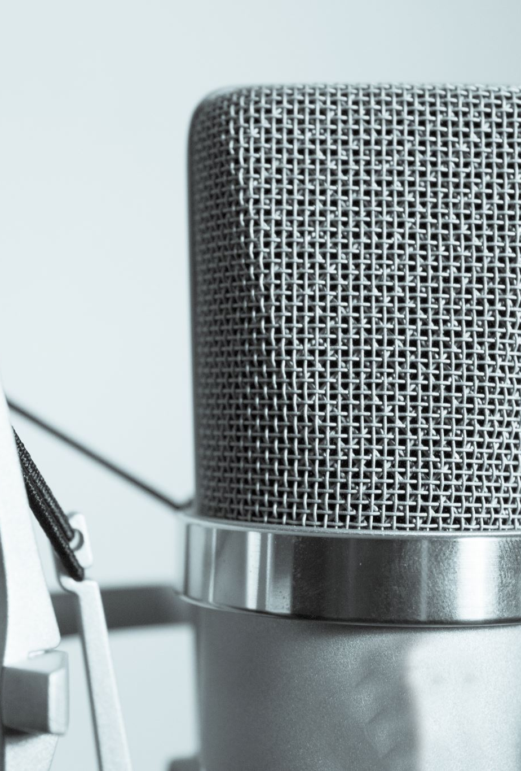
Objective
Speaker Recognition is the problem of identifying a speaker from a recording of their speech. It is an important topic in Speech Signal Processing and has a variety of applications. Voice is one metric which apart from being natural to the users, provides comparable and sometimes even higher levels of security when compared to some traditional biometric approaches. The main principle behind speaker recognition is extraction of features from speech which are characteristic to a speaker, followed by training on a data set and testing. This study aims to evaluate different pre-processing, feature extraction, and machine learning techniques on audios recorded works well for speaker recognition and classification.

Slide 4
Literature Survey
Joseph P Cambell designed a tutorial for automatic speaker recognition via LSP frequency features and achieved an accuracy of 98.9% for speaker identification on high quality telephone bandwidth speech collected in real world office environments. Joon Son Chung et al. implemented a deep CNN based speaker embedding system to map voice spectrograms to a Euclidean Space. This implementation provided a 4.42% EER (Equal Error Rate) on the ResNet50 Model on the VoxCeleb1 dataset for speaker verification. Douglas A Reynolds implemented a GMM (Gaussian Mixture Model) which achieved a 99.5% on a 630-speaker database which included TIMIT, NTIMIT, Switchboard, and YOHO. Although the accuracy dropped to 60.7% in NTIMIT database after the addition of telephone line degradation the verification task gave only 0.24% EER. An overall EER of 0.51% and a false rejection rate of 0.65% at a 0.1% false-acceptance rate were obtained. Jose A Lopez et al. implemented a speaker recognition system for anomaly detection for different machine sounds. The model achieved close to perfect results from 95% to 99% for five out of six machine sounds.

Slide 5
Dataset Description
This dataset contains speeches of these prominent leaders:
Benjamin Netanyahu - 1500 wav files
Jens Stoltenberg - 1500 wav files
Julia Gillard - 1500 wav files
Margaret Tacher - 1500 wav files
Nelson Mandela - 1500 wav files
which also represents the folder names. Each audio in the folder is a one-second 16000 sample rate PCM encoded.

Slide 6
WORKFLOW
LOADING DATASET
COMPUTING SPECTOGRAMS
PROCESSING DATA
CREATING DEEP LEARNING MODEL
EXTRACTING FEATURES
MACHINE LEARNING CLASSIFIER

Slide 7
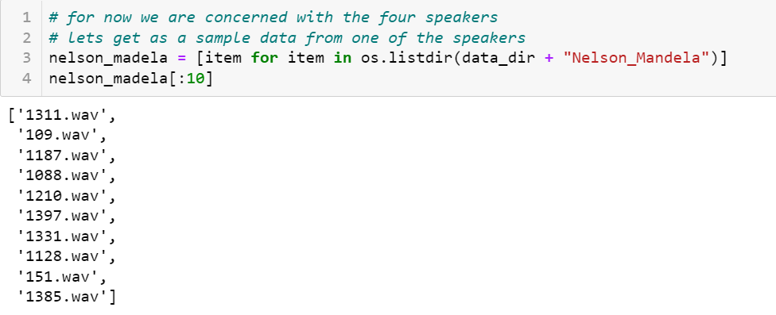

Slide 8
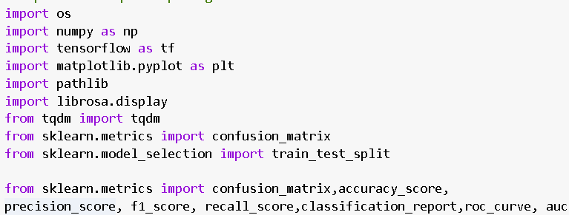

Tools and Libraries

Slide 9

Spectrograms
The FFT is computed on overlapping windowed segments of the signal, and we get what is called the spectrogram
A mel spectrogram is a spectrogram where the frequencies are converted to the mel scale.

Slide 10
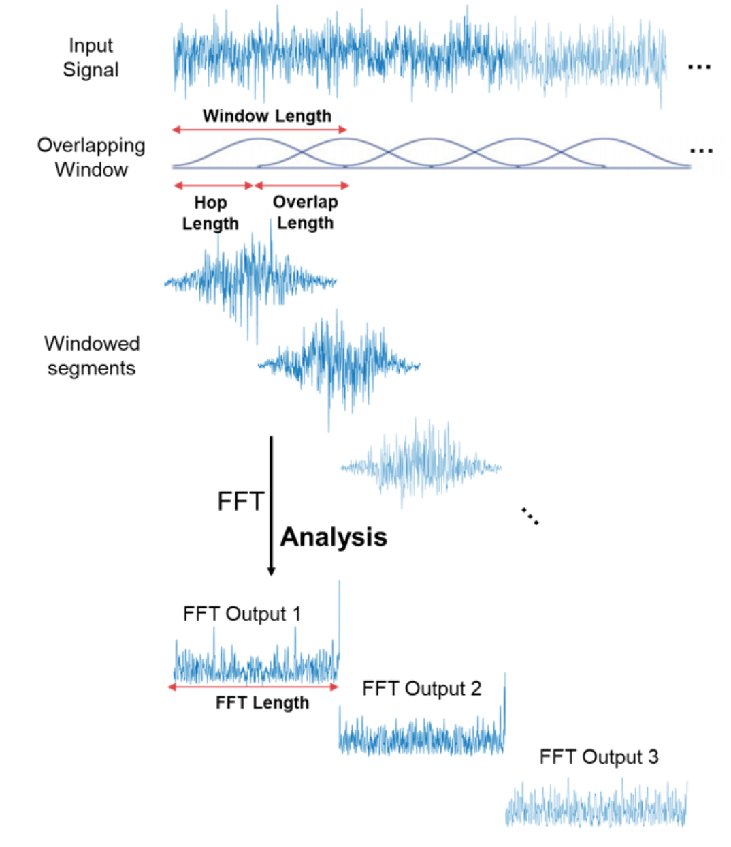
SPECTROGRAM
We can visualize a spectrogram as a bunch of FFTs stacked on top of each other.
It is a way to visually represent a signal’s loudness, or amplitude, as it varies over time at different frequencies.

Slide 11
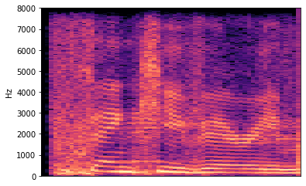
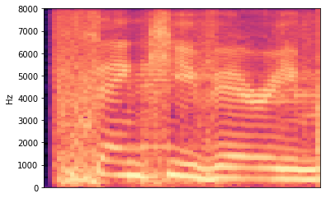
Plots
SPECTROGRAM & MELSPECTROGRAM FOR JULIA GILLARD

Slide 12
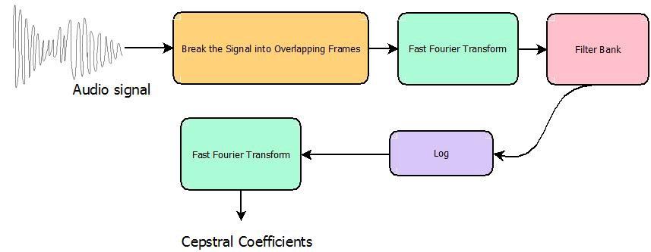
Feature Extraction
Here, Filter Bank refers to the mel filters (coverting to mel scale) and Cepstral Coefficients are nothing but MFCCs.

Slide 13
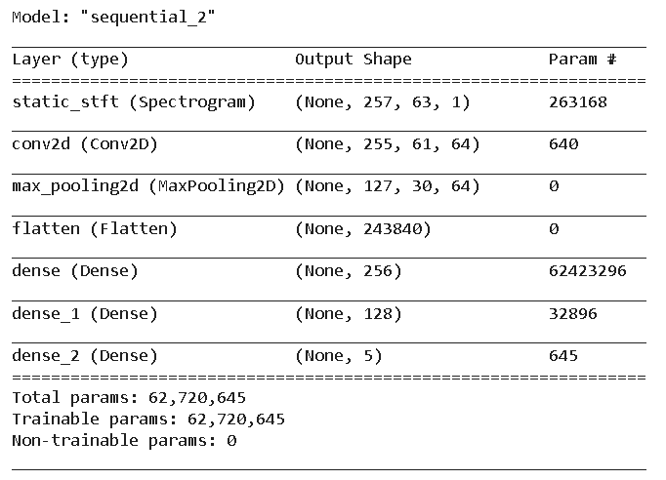
Implementation

Slide 14
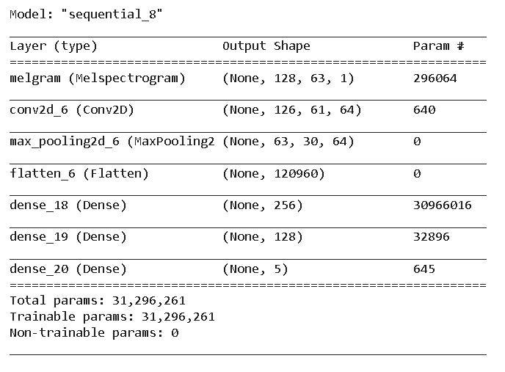
Implementation

Slide 15
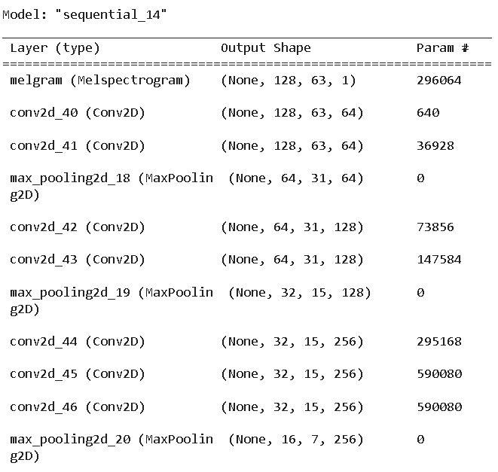
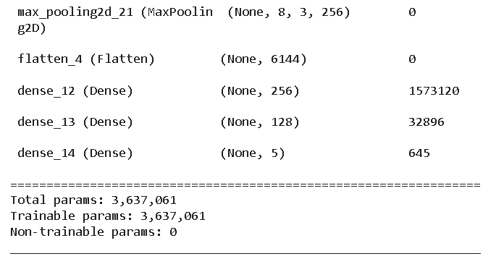
Implementation

Slide 16
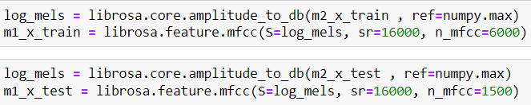
EXTRACTING MFCC FROM MEL-SPECTROGRAM
There are two steps: 1. Take logs of Mel spectrogram. 2. Compute DCT on logs.

Slide 17
Machine learning classification
LOGISTIC REGRESSION
RANDOM FOREST
DECISION TREE
KNN
GAUSSIAN NAÏVE BAYES
SVM

Slide 18
Evaluation Metrics
ACCURACY
PRECISON
RECALL
F1-SCORE
CONFUSION MATRIX

Slide 19
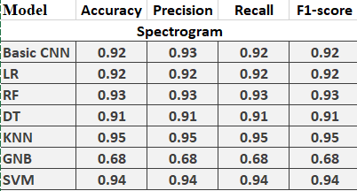
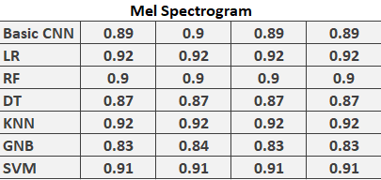
Experiments & Results (BASIC CNN)

Slide 20
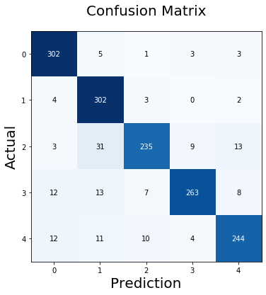
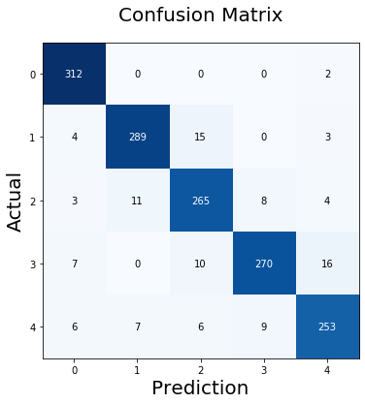
RESULTS FOR DL MODEL
SPECTROGRAM
MEL SPECTROGRAM

Slide 21
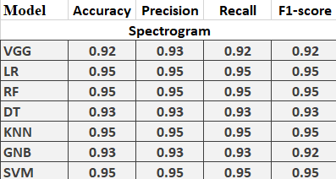
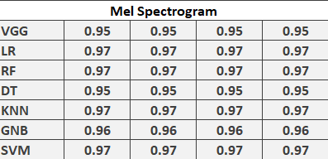
Experiments & Results (VGG)

Slide 22
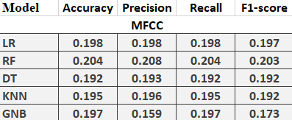
MFCC FROM MEL SPECTROGRAM

